Slide 1
Introduction to Computer Simulation of Physical Systems
(Lecture 2)
PHYS 3061

Slide 2
Inheritance
The falling ball and the simple harmonic oscillator have important features in common.
Both are models of physical systems
  all its mass were concentrated at a single point.
  Writing two separate classes by cutting and pasting is straightforward and reasonable because the programs are small and easy to understand.
  But this approach fails when the code becomes more complex.

Slide 3
For example, suppose that you wish to simulate a model of a liquid consisting of particles that interact with one another according to some specified force law.
Because such simulations are now standard, efficient code for such simulations is available.
In principle, it would be desirable to use an already written program, assuming that you understood the nature of such simulations.

Slide 4
However, in practice, using someone else’s program can require much effort if the code is not organized properly.
Fortunately, this situation is changing as more programmers learn object oriented techniques, and write their programs so that they can be used by others without needing to know the details of the implementation.

Slide 5
For example, suppose that you decided to modify an already existing program by changing to a different force law.
You change the code and save it under a new name.
Later you discover that you need a different numerical algorithm to advance the particles’ positions and velocities.
You again change the code and save the file under yet another name.

Slide 6
At the same time the original author discovers a bug in the initialization method and changes her code.
Your code is now out of date because it does not contain the bug fix.
Although strict documentation and programming standards can minimize these types of difficulties, a better approach is to use object oriented features such as inheritance.
Inheritance avoids duplication of code and makes it easier to debug a number of classes without needing to change each class separately.

Slide 7
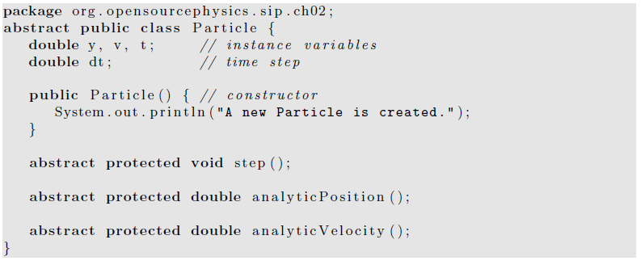
The abstract keyword : define the Particle class without knowing how the step, analyticPosition, and analyticVelocity methods will be implemented.
Abstract classes are useful in part because they serve as templates for other classes.
The abstract class contains some but not all of what a user will need.
By making the class abstract, we must express the abstract idea of “particle” explicitly and customize the abstract class to our needs.

Slide 8
By using inheritance we now extend the Particle class (the superclass) to another class (the subclass).
The FallingParticle class implements the three abstract methods.
Note the use of the keyword extends.
We also have used a constructor with the initial position and velocity as arguments.

Slide 9
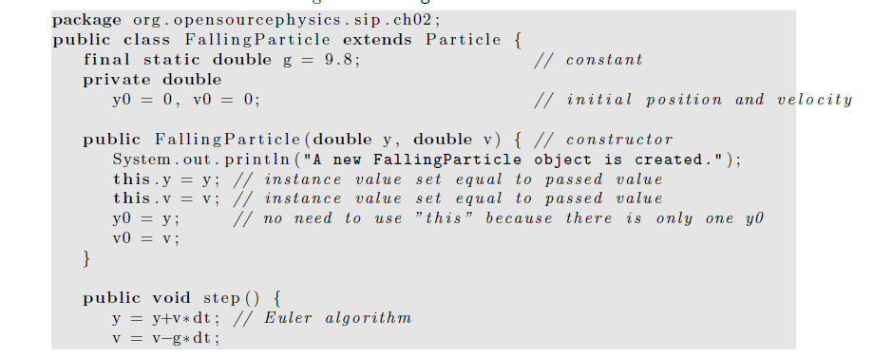
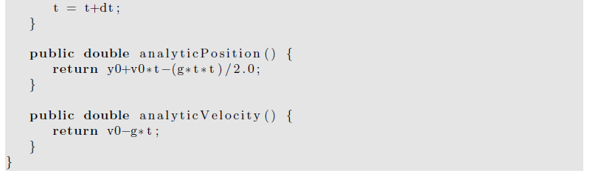

Slide 10
Random Processes
random walks on a lattice
The generation of random number sequences
  Question: the verification of randomness is a finite or infinite process?

Slide 11
Order to Disorder
Deterministic system can appear to be random
  Any examples?
Chance can generate statistically predictable outcomes.
  One example:
    The ruin of gamblers.
      If we bet often on the outcome of game with an edge less than 50%
      We lose!
      What if you are betting in a game with an edge greater than 50%, are you guaranteed winning the game?

Slide 12
One example to illustrate the tendency of systems of many particles to evolve to a well defined state.
  A box divided into two parts of equal volume.
  The left half contains N identical particles
  The right half is empty.
  We make a small hole in the partition,
  What will happen?

Slide 13
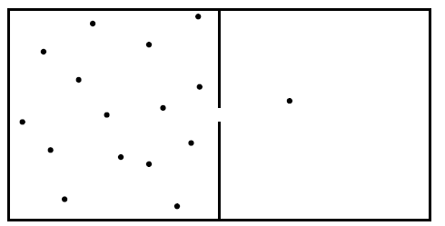
Of course, after some certain time, each half will contain N/2 particles
  Equilibrium.
How to simulate this process?

Slide 14
One option is to assign an initial velocity to each particle and wait for the system to evolve.
  This is a deterministic approach.
  We can assume that each particle moves in a straight line until it hits a wall of the box or undergo an elastic collision with another particle.
  You will be asked to write code to do this kind of simulations in latter lab sessions.
  This is actually a basic version of MD!
Any drawbacks of such simulations?

Slide 15
a probabilistic model based on a random process
Basic assumption:
  the motion of the particles is random
  The particles do not interact with one another.
    probability per unit time that a particle goes through the hole in the partition is the same for all N particles regardless of the number of particles in either half.
  assume that the size of the hole is such that only one particle can pass through at a time.

Slide 16
First, model the motion of a particle passing through the hole
  by choosing one of the N particles at random and moving it to the other side.
  For visualization purposes we will use arrays to specify the position of each particle.
  We then randomly generate an integer i between 0 and N − 1 and change the arrays appropriately.
  The tool we need to simulate this random process is a random number generator.

Slide 17
Counterintuitive!
  we can use a deterministic computer to generate sequences of random numbers.
A set of numbers that appear statistically random, but are in fact generated by a deterministic algorithm.
Pseudorandom number generators.
  to distinguish their output from intrinsically random physical processes
    such as the time between clicks in a Geiger counter near a radioactive sample.
In the text book, we will be content to use the random number generator supplied with Java
  although the random number generators included with various programming languages vary in quality.
  The method Math.random() produces a random number r that is uniformly distributed in the interval 0 ≤ r < 1.
  How to generate a random integer i between 0 and N − 1?

Slide 18
int i = ( int ) (N*Math . random ( ) ) ;
The effect of the (int) cast is to eliminate the decimal digits from a floating point number.
  For example, (int)(5.7) = 5.
The algorithm for simulating the evolution of the model can be summarized by the following steps:
  1. Use a random number generator to choose a particle at random.
  2. Move this particle to the other side of the box.

Slide 19
  3. Give the particle a random position on the new side of the box. This step is for visualization purposes only.
  4. Increase the “time” by unity.
    This definition of time is arbitrary.
Next pages will show Class Box that implements this algorithm and class BoxApp plots the evolution of the number of particles on the left half of the box.

Slide 20
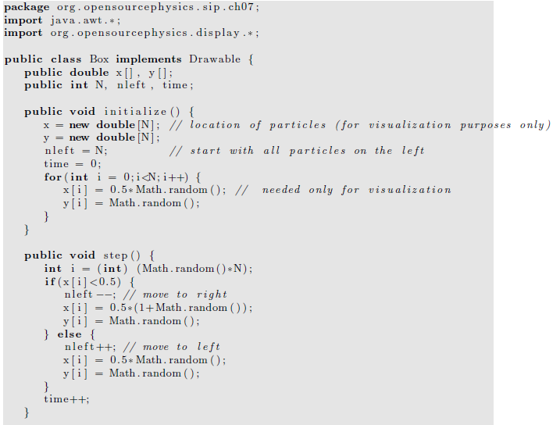

Slide 21
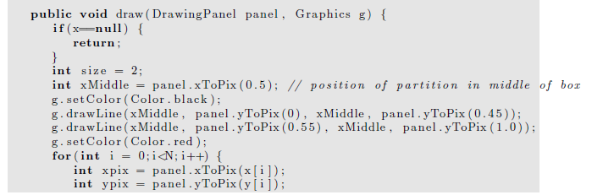
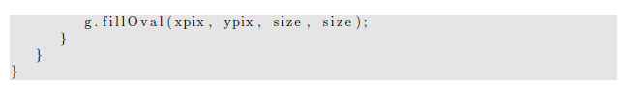

Slide 22
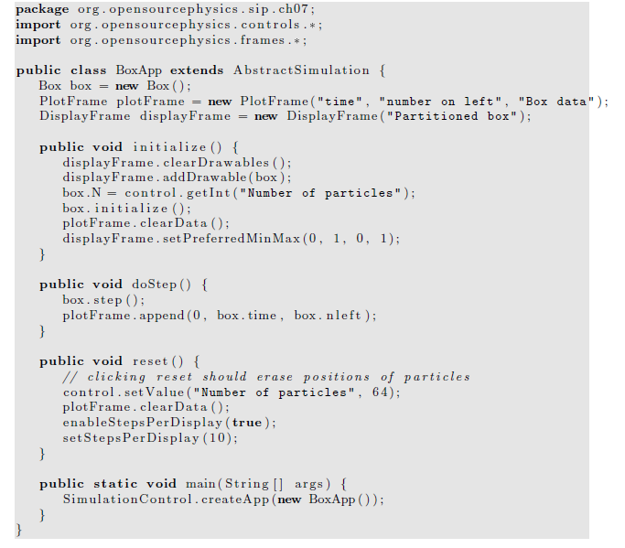

Slide 23
Questions when you run the simulation
How long does it take for the system to reach equilibrium?
How does this time depend on the number of particles? After the system reaches equilibrium, what is the magnitude of the fluctuations?
How do the fluctuations depend on the number of particles?
  Few particles vs. many particles.
  Odd and even?

Slide 24
Random Walks
To characterize the motion of a dust particle in the atmosphere
A given dust particle collides with molecules in the atmosphere
  it changes its direction frequently
  its motion appears to be random.
A simple model for the trajectory of a dust particle in the atmosphere is based on the assumption
  the particle moves in any direction with equal probability.
Such a model is an example of a random walk.

Slide 25
The original statement of a random walk
  in the context of a drunken sailor.
  If a drunkard begins at a lamp post and takes N steps of equal length in random directions,
  How far will the drunkard be from the lamp post?
We will find that
  the mean square displacement of a random walker, for example, a dust particle or a drunkard, grows linearly with time!
This result and its relation to diffusion leads to many applications that might seem to be unrelated to the original drunken sailor problem.

Slide 26
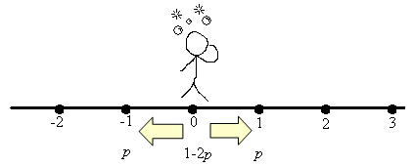
First consider an idealized example of a random walker
  that can move only along a line.
Suppose that the walker begins at x = 0 and that each step is of equal length a.
At each time interval
  the walker has a probability p of a step to the right
  and a probability q = 1 − p of a step to the left.
  The direction of each step is independent of the preceding one.
After N steps the displacement x of the walker from the origin is given by x_{n}=Σs_{i} , where s_{i} = ±a. i: from 1 to N.

Slide 27
For p = 1/2 we can generate one walk of N steps
  by flipping a coin N times
  and increasing x by a each time the coin is heads
  and decreasing x by a each time the coin is tails.

Slide 28
If we average over a sufficient number of walks of N steps,
  then the average of x_{N}, denoted by ⟨x_{N}⟩, would be (p−q)Na.
We can derive this result by writing
  ⟨x⟩ = Σ⟨s_{i}⟩ =N⟨s⟩, i: from 1 to N
  because the average of the sum is the sum of the averages,
  and the average of each step is the same.
We have ⟨s⟩ = p(a) + q(−a) = (p − q)a, and the result follows.
For simplicity, we will frequently drop the subscript N and write ⟨x⟩.

Slide 29
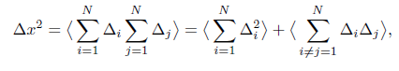
Because ⟨x⟩ = 0 for p = 1/2, we need a better measure of the extent of the walk.
One measure is the displacement squared:
x²_{N} =[Σ s_{i}]²,
  i: from 1 to N.
For p ≠ 1/2, it is convenient to consider the mean square net displacement Δx² defined as
Δx² ≡ ⟨(x − ⟨x⟩)²⟩ = ⟨x²⟩ − ⟨x⟩².
  (We have written Δx² rather than ⟨Δx²⟩ for simplicity.)
  To determine Δx², we write Δx² as the sum of two terms:

Slide 30
  where Δ_{i} = s_{i} − ⟨s⟩.
The first sum on the right-hand side of includes terms for which i = j;
the second sum is over i and j with i≠j.
Because each step is independent, we have
  ⟨Δ_{i}Δ_{j}⟩ = ⟨Δ_{i}⟩⟨Δ_{j}⟩.
This term is zero because ⟨Δi⟩ = 0 for any i.
Δx² equals
  N⟨Δ²⟩ = N[⟨s²⟩−⟨s⟩²] = N[a²−(p−q)²a²] = N4pqa²,
  where we have used the fact that p+q = 1.
Hence Δx² = 4pqNa². (analytical result)

Slide 31
We can gain more insight into the nature of random walks by doing a Monte Carlo simulation,
  by using a computer to “flip coins.”
  The implementation of the random walk algorithm is simple, for example,
if (p < Math.random( ) ) {
x++;
}
else {
x--;
}

Slide 32
Clearly we have to sample many N step walks
  because in general, each walk will give a different outcome.
We need to do a Monte Carlo simulation many times and average over the results to obtain meaningful averages.
Each N-step walk is called a trial.
How do we know how many trials to use?

Slide 33
  The simple answer is to average over more and more trials until the average results don’t change within the desired accuracy.
  The more sophisticated answer is to do an error analysis similar to what we do in measurements in the laboratory.

Slide 34
The more difficult parts of a program to simulate random walks are associated with bookkeeping.
The walker takes a total of N steps in each trial and the net displacement x is computed after every step.
Our convention will be to use a variable name ending in Accumulator (or Accum) to denote a variable that accumulates the value of some variable.
In next page, we provide two classes to be used to simulate random walks.

Slide 35
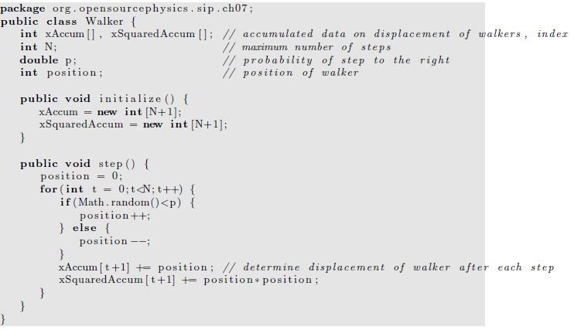

Slide 36
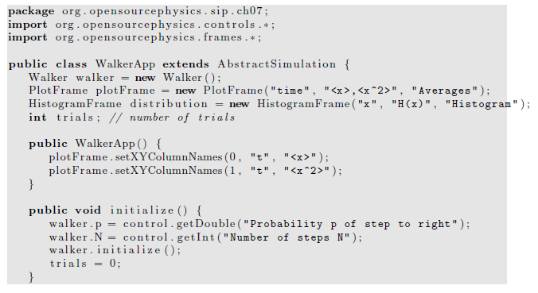

Slide 37
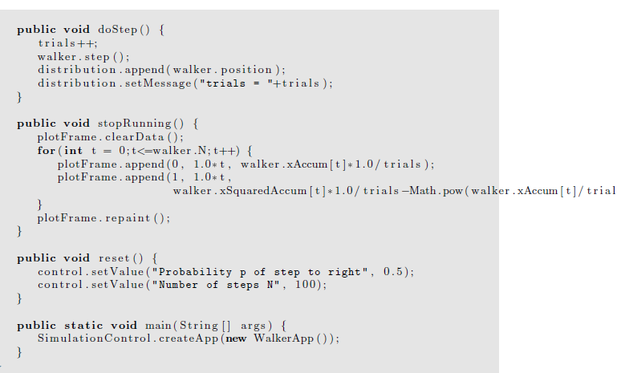
s,2)

Slide 38
The class WalkerApp displays the distribution of values of the displacement x after N steps.
One way of determining the number of times that the variable x has a certain value would be to define a one-dimensional array, probability, and let probability[x] += 1;
Any problems with this implementation?

Slide 39
In this case because x takes only integer values, the array index of probability is the same as x itself.
However, the above statement does not work in Java because x can be negative as well as positive.
What we need is a way of mapping the value x to a bin or index number.
The HistogramFrame class, which is part of the Open Source Physics display package, does this mapping automatically using the Java Hashtable class.

Slide 40
In simple data structures data is accessed by an index that indicates the location of the data in the data structure.
Hashtable data is accessed by a key, which in our case is the value of x.
A hashing function converts the key to an index.
The append method of the HistogramFrame class takes a value, finds the index using a hashing function, and then increments the data associated with that key.
The HistogramFrame class also draws itself.

Slide 41
The HistogramFrame class is very useful for taking a quick look at the distribution of values in a data set.
You do not need to know how to group the data into bins or the range of values of the data.
The default bin width is unity, but the bin width can be set using the setBinWidth method.
See WalkerApp for an example of the use of the HistogramFrame class.
Frequently, we wish to use the histogram data to compute other quantities.
You can collect the data using the Data Table menu item in HistogramFrame and copy the data to a file.
Another option is to include additional code in your program to analyze the data.
For more details, you can read the text book.

Slide 42
Further practice
Compute P_{N}(x), the probability that the displacement of the walker from the origin is x after N steps.
What is the difference between the histogram, that is, the number of occurrences, and the probability?
  Consider N = 10 and N = 40 and at least 1000 trials.
Does the qualitative form of P_{N}(x) change as the number of trials increases?
What is the approximate width of P_{N}(x) and the value of P_{N}(x) at its maximum for each value of N?

Slide 43
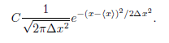
What is the approximate shape of the envelope of P_{N}(x)?
Does the shape change as N is increased?
Fit the envelope P_{N}(x) for sufficiently large N to the continuous function.

Slide 44
This form is the standard form of the Gaussian distribution with C = 1.
The easiest way to do this fit is to plot your results for P_{N}(x) and the form on the same graph using your results for ⟨x⟩ and Δx² as input parameters.
Visually choose the constant C to obtain a reasonable fit.
The lab 1, you will be asked to implement a more complicated random walk model, like 3D, uneven step size….
For more topics in random walk, you can also read the text book.

Slide 45
Method of Least Squares
The most common method for finding the best straight line fit to a series of measured points is called linear regression or least squares.
Suppose we have n pairs of measurements (x1, y1), (x2, y2), . . . , (xn, yn) and that the errors are entirely in the values of y.
For simplicity, we assume that the uncertainties in {yi} all have the same magnitude.
Our goal is to obtain the best fit to the linear function
  y = mx + b.

Slide 46
The problem is to calculate the values of the parameters m and b for the best straight line through the n data points.
The difference,
  d_{i} = y_{i} − mx_{i} − b
is a measure of the discrepancy in y_{i}.

Slide 47
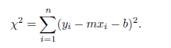
It is reasonable to assume that the best pair of values of m and b are those that minimize the quantity
Why should we minimize the sum of the squared differences between the experimental values, yi, and the analytical values, mx_{i}+b, and not some other function of the differences?

Slide 48
The justification is based on the assumption that if we did many simulations or measurements,
  the values of d_{i} would be distributed according to the Gaussian distribution.
Based on this assumption, it can be shown that the values of m and b that minimize χ yield a set of values of mx_{i} +b that are the most probable set of measurements that we would find based on the available information.

Slide 49
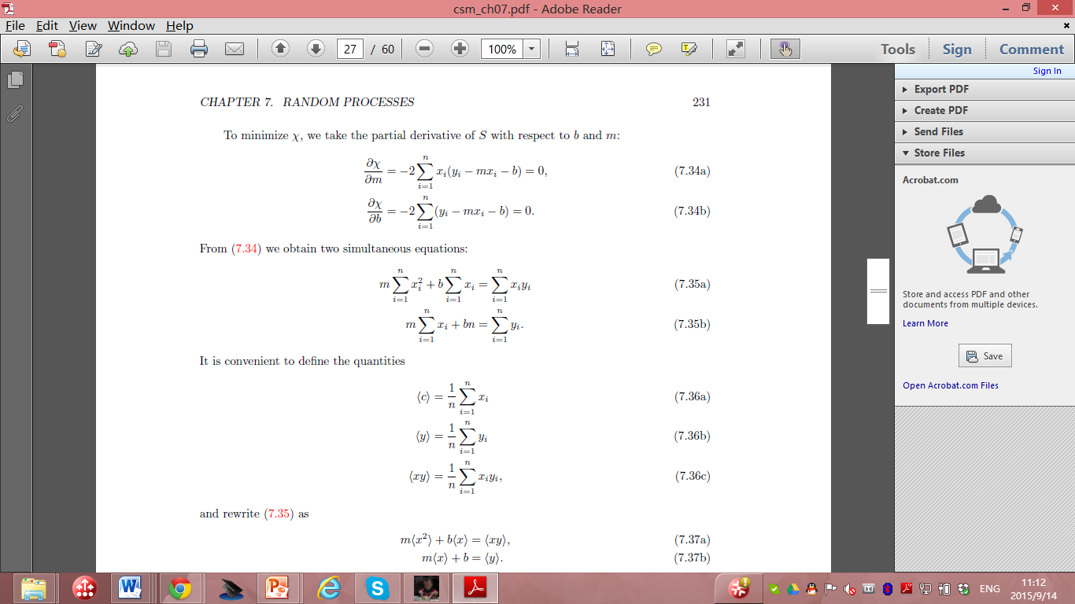
To minimize χ, we take the partial derivative with respect to b and m:

Slide 50
Then we obtain two equations:

Slide 51

It is convenient to define the quantities

Slide 52
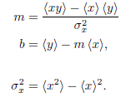
Rewrite the equation set as:
  m⟨x²⟩ + b⟨x⟩ = ⟨xy⟩, m⟨x⟩ + b = ⟨y⟩.
The solution is:
Where:

Slide 53
the slope m and the intercept b of the best straight line through the n data points.
Example: consider the data shown in Table on next page for a one-dimensional random walk.
To make the example more interesting, suppose that the walker takes steps of length 1 or 2 with equal probability. The direction of the step is random and p = 1/2.

Slide 54
N Δx2
8 19.43
16 37.65
32 76.98
64 160.38
assume that the mean square displacement Δx² obeys the general relation Δx² = aN^{2γ},
  with an unknown exponent ν and a is a constant.
  Note that the fitting problem is nonlinear, that is,
Often a problem that looks nonlinear can be turned into a linear problem by a change of variables.
In this case we convert the nonlinear relation to a linear relation by taking the logarithm of both sides:
  ln(Δx²) = ln a + 2ν lnN.

Slide 55
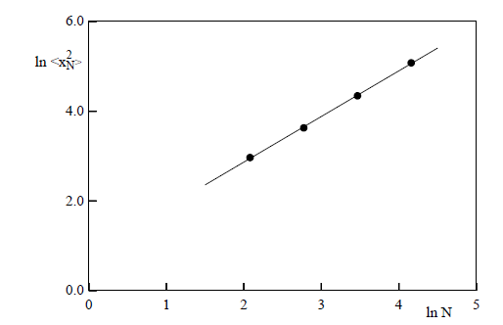
m = 1.02 and b = 0.83.
Hence, we conclude from our limited data and the relation 2ν = m that ν ≈ 0.51, which is consistent with the expected result ν = 1/2.

Slide 56

Random Number sequences
So far we have used the random number generator supplied with Java.
In principle, we could have generated these numbers from a random physical process, such as the decay of radioactive nuclei (refer to the text book for detailed discussions) or the thermal noise from a semiconductor device.
In practice, random number sequences are generated from a physical process only for specific purposes such as a lottery.

Slide 57
Although we could store the outcome of a random physical process so that the random number sequence would be both truly random and reproducible, such a method would usually be inconvenient and inefficient in part because we often require very long sequences.
  Any example of such random number generators in quantum physics?
In practice, we use a digital computer, a deterministic machine, to generate sequences of pseudorandom numbers.

Slide 58
such a distinction is unimportant if the sequence satisfies all our criteria for randomness.
  Although these sequences cannot be truly random
Common to refer to random number generators
  even though we really mean pseudorandom number generators.

Slide 59
Most random number generators yield a sequence
  in which each number is used to find the succeeding one according to a well defined algorithm.
  The most important features of a desirable random number generator:
    its sequence satisfies the known statistical tests for randomness,
We also want the generator to be efficient and machine independent, and the sequence to be reproducible. (WHY?)

Slide 60
The most widely used random number generator:
  linear congruential method.
One advantage
  very fast.
For a given seed x0, each number in the sequence is determined by the one-dimensional map.
  x_{n} = (ax_{n−1} + c) mod m

Slide 61
  x_{n} = (ax_{n−1} + c) mod m
where a, c, and m as well as x_{n} are integers
The notation y = z mod m means that m is subtracted from z until 0 ≤ y < m.
the multiplier a, the increment c, and the modulus m
  What’s the maximum possible period?

Slide 62
In general, the period depends on all three parameters.
  For example, if a = 3, c = 4, m = 32, and x0 = 1, the sequence : 1, 7, 25, 15, 17, 23, 9, 31, 1, 7, 25,
The period is 8
  rather than the maximum possible value of m = 32.
If we choose a, c, and m carefully such that the maximum period is obtained,
  then all possible integers between 0 and m − 1 would occur in the sequence.

Slide 63
To have random numbers r in the unit interval 0 ≤ r < 1 rather than random integers, random number generators usually return the ratio x_{n}/m
  which is always less than unity.
  Several rules have been developed to obtain the longest period.

Slide 64
Another popular random number generator:
  the generalized feedback shift register method,
  bit manipulation.
  Every integer is represented as a series of 1s and 0s called bits.
  These bits can be shuffled by using the bitwise exclusive or operator ⊕ (xor) defined by a ⊕ b = 1 if the bits a≠ b; a ⊕ b = 0 if a = b.
  The nth member of the sequence is given by
    x_{n} = x_{n−p} ⊕ x_{n−q},

Slide 65
In Java and C the exclusive or operation on the integers m and n is written as mˆn.
The algorithm for producing the random numbers after p integers have been produced:
  Initially the index, k, can be set to 0.
  1. If k < q, set j = k + q, else set j = k − p + q.
  2. Set x_{k} = x_{k} ⊕ x_{j} ; x_{k} is the desired random number for this iteration.
  If a random number between 0 and 1 is desired, divide x_{k} by the maximum possible integer that the computer can hold.
  3. Increment k to (k + 1) mod p.

Slide 66
Because the exclusive or operator and bit manipulation is very fast,
  this random number generator is very fast.
  However, the period may not be long enough for some applications and the correlations between numbers might not be as good as needed.

Slide 67
general nature:
  numbers in the sequence are used to find the succeeding ones according to a well defined algorithm.
  The sequence is determined by
    the seed,
    the first number of the sequence,
    or the first p members of the sequence for the generalized feedback shift register and related generators.
  Usually, the maximum possible period is related to the size of the computer word,
  for example, 32, or 64 bits.
  The choice of the constants and the proper initialization of the sequence is very important and thus these algorithms must be implemented with care.

Slide 68
no necessary and sufficient test for the randomness of a finite sequence of numbers;
  It is apparently random.
  Because no single statistical test is a reliable indicator, we need to consider several tests.
  For details of the statistical tests, please read the textbook.

Slide 69
Many of these tests can be stated in terms of random walks.
  Random walk. A test based on the properties of random walks has been proposed by Vattulainen et al.
  Assume that a walker begins at the origin of the x-y plane and walks for N steps.
  Average over M walkers and count the number of walks that end in each quadrant qi.
  Use the χ2 test with y_{i} → q_{i}, M = 4, and E_{i} = M/4.
  If χ2 > 7.815 (a 5% probability if the random number generator is perfect), we say that the run fails.
  The random number generator fails if two out of three independent runs fail.
  The probability of a perfect generator failing two out of three runs is approximately 3×0.95×(0.05)² ≈ 0.007.

Slide 70
Variational Methods
Many problems in physics can be formulated in terms of a variational principle.
How Monte Carlo methods can be applied to these problems?
A more sophisticated application of Monte Carlo methods to a variational problem in quantum mechanics will be discussed in the Monte Carlo chapter in PHYS4061.

Slide 71
Light rays
  This description of light propagation, called geometrical or ray optics, is applicable when the wavelength of light is small compared to the linear dimensions of any obstacles or openings.
  The path of a light ray can be formulated in terms of Fermat’s principle of least time: A ray of light follows the path between two points (consistent with any constraints) that requires the least amount of time.
Fermat’s principle can be adopted as the basis of geometrical optics.

Slide 72
For example, Fermat’s principle implies that light travels from a point A to a point B in a straight line in a homogeneous medium.
Because the speed of light is constant along any path within the medium, the path of shortest time is the path of shortest distance,
  that is, a straight line from A to B.
What happens if we impose the constraint that the light must strike a mirror before reaching B?

Slide 73
The speed of light in a medium can be expressed in terms of c, the speed of light in a vacuum, and the index of refraction n of the medium : v =c / n
Suppose that a light ray in a medium with index of refraction n₁ passes through a second medium with index of refraction n₂.
The two media are separated by a plane surface.
We now show how we can use Fermat’s principle and a simple Monte Carlo method to find the path of the light.
The analytical solution to this problem using Fermat’s principle is found in many texts.

Slide 74
Our strategy, as implemented in class Fermat, is to begin with a straight path and to make changes in the path at random.
These changes are accepted only if they reduce the travel time of the light.

Slide 75
Some of the features of Fermat and FermatApp include:
1. Light propagates from left to right through N regions.
  The index of refraction n[i] is uniform in each region [i].
  The index i increases from left to right.
  We have chosen units such that the speed of light in vacuum equals unity.
2. Because the light propagates in a straight line in each medium, the path of the light is given by the coordinates y[i] at each boundary.
3. The coordinates of the light source and the detector are at (0,y[0]) and (N,y[N]) respectively, where y[0] and y[N] are fixed.

Slide 76
4 The path is the connection of the set of points at the boundary of each region.
5. The path of the light is found by choosing the boundary i at random and generating a trial value of y[i] that differs from its previous value by a random number between -dy to dy.
  If the trial value of y[i] yields a shorter travel time, this value becomes the new value for y[i].
6. The path is redrawn whenever it is changed.

Slide 77
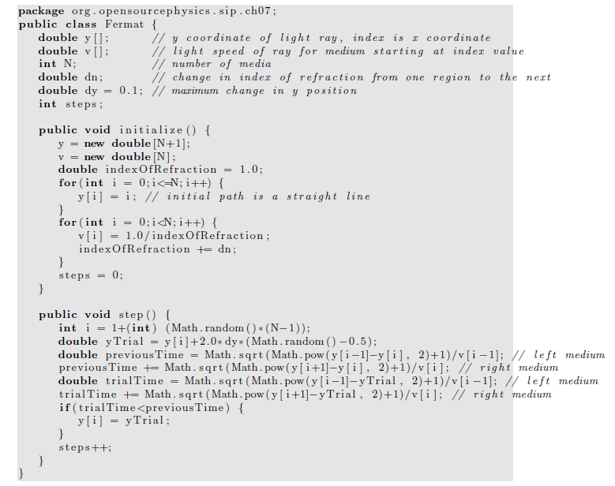

Slide 78
